Slide 1
Human in the loop reinforcement learning
Matei Ciocarlie
Shuran Song
Siddharth Singi

Slide 2
Introduction
Consider a discrete action environment with stochasticity. Despite the stochasticity in the environment, an RL agent will manage to learn an acceptable policy, however, during runtime the agent will incur heavy penalties because of the stochasticity.
We would like to propose a method which can minimize the damage by the stochasticity by introducing a human or an expert into this problem

Slide 3
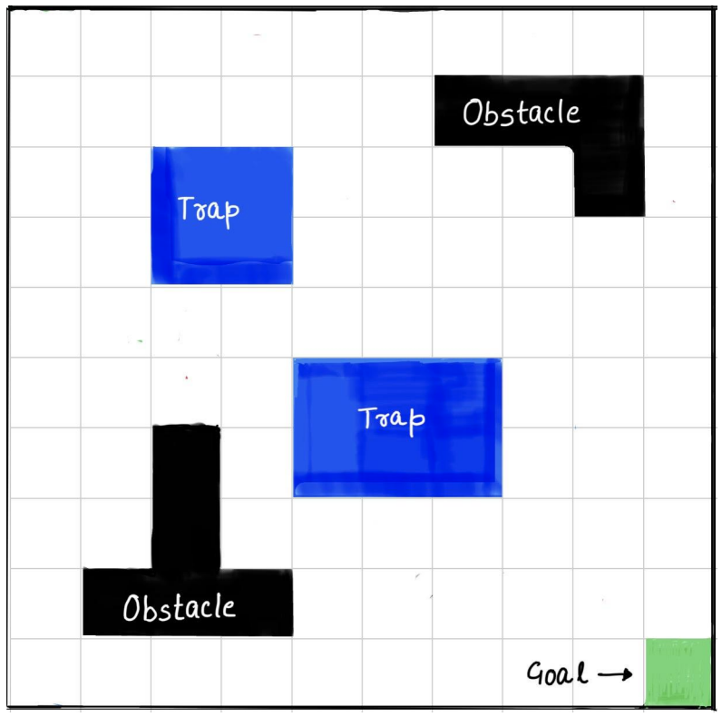
Experiment in the GridWorld
An agent can start in any of the white cells, with an aim to go to the goal.
The actions our agent can take are: [Up, Down, Left, Right] numbered [0, 1, 2, 3]
The episode ends if you reach the goal or enter the trap
If you hit an obstacle or wall you will return to the same cell
Reward structure:
-2 for every step
-100 if it enters the trap
+100 if it reaches the goal
Stochasticity (Grid Epsilon)
For every action there is a 30% chance that the environment will take another action chosen at random. There is only a 70% chance that the action chosen by the agent will be executed by the environment. This high stochasticity makes it difficult for the agent to learn the correct policy. We will call this parameter the grid_epsilon: 0.3

Slide 4
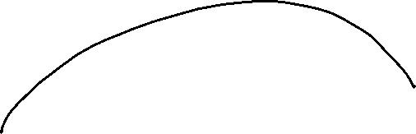
Let’s say you start in this state. You decide to go up in order to avoid the trap, even then there is a 30/4=7.25% chance that you will end up in the trap, ending the episode and getting a reward of -100.
Because of this it becomes very difficult for even a well-trained agent to get a high reward.

Slide 5
Vanilla Method
The standard way of solving this problem is maintaining a q table whose values will be learned while training an agent. The final learned policy will be updated using our Bellman equations:
This will give us a policy that can be used during runtime

Slide 6
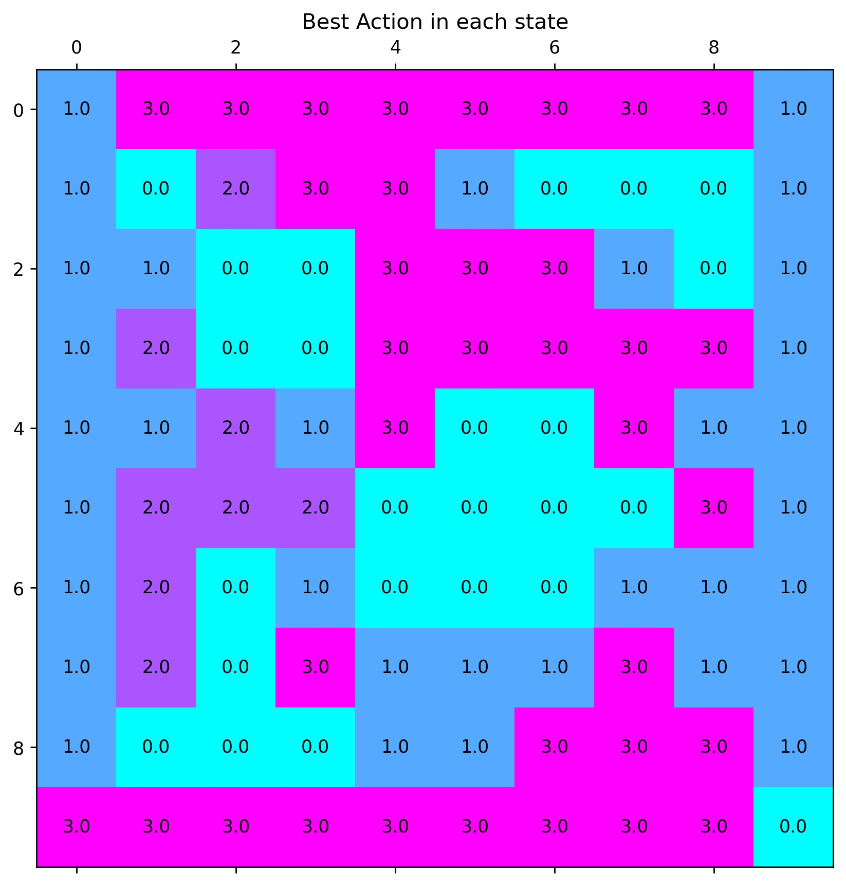
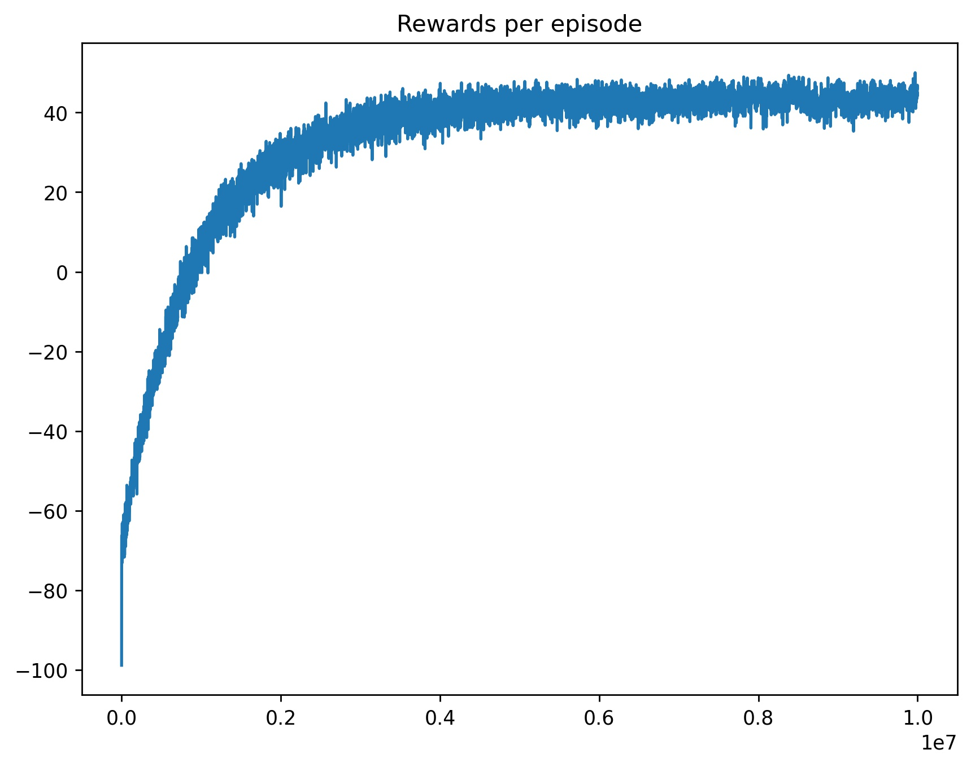
Converged policy
Returns per episode during training
Hyperparameters during training:
Number of episodes: 10million
Grid Epsilon: 0.3
Notes:
Note the kind of actions the agent has converged to near the traps to take the agent away from the traps.

Slide 7
ALG2
We want to minimize the damage done by the stochasticity by introducing an expert which the agent can call in case it is unsure of the reward it will receive. An expert is someone who has complete knowledge of how the environment behaves and can circumvent the stochasticity.
As an example, consider an agent that has 4 actions to choose from, if the agent is unsure about the q values of these actions (high variance of q value) in that case it can call an expert, which understands the environment, and will be able to take the action on the agent’s behalf.

Slide 8
Variance of the return of an action
This grid-world is trained using a Q-Table. Where we are storing and updating the q value of every action during training
In some scenarios the stakes of our actions may be too high, and our agent is unsure about the q values for the actions, i.e the variance of the return for our action is high. In such scenarios we would like to call an expert to take an action for us. More on how the expert is called later, what we need to know though is that the expert knows how the environment behaves so when the expert is called the stochasticity of the environment is not applied.
We need to figure out a way to compute the variance of the return of our action. There are two ways we can do this:

Slide 9
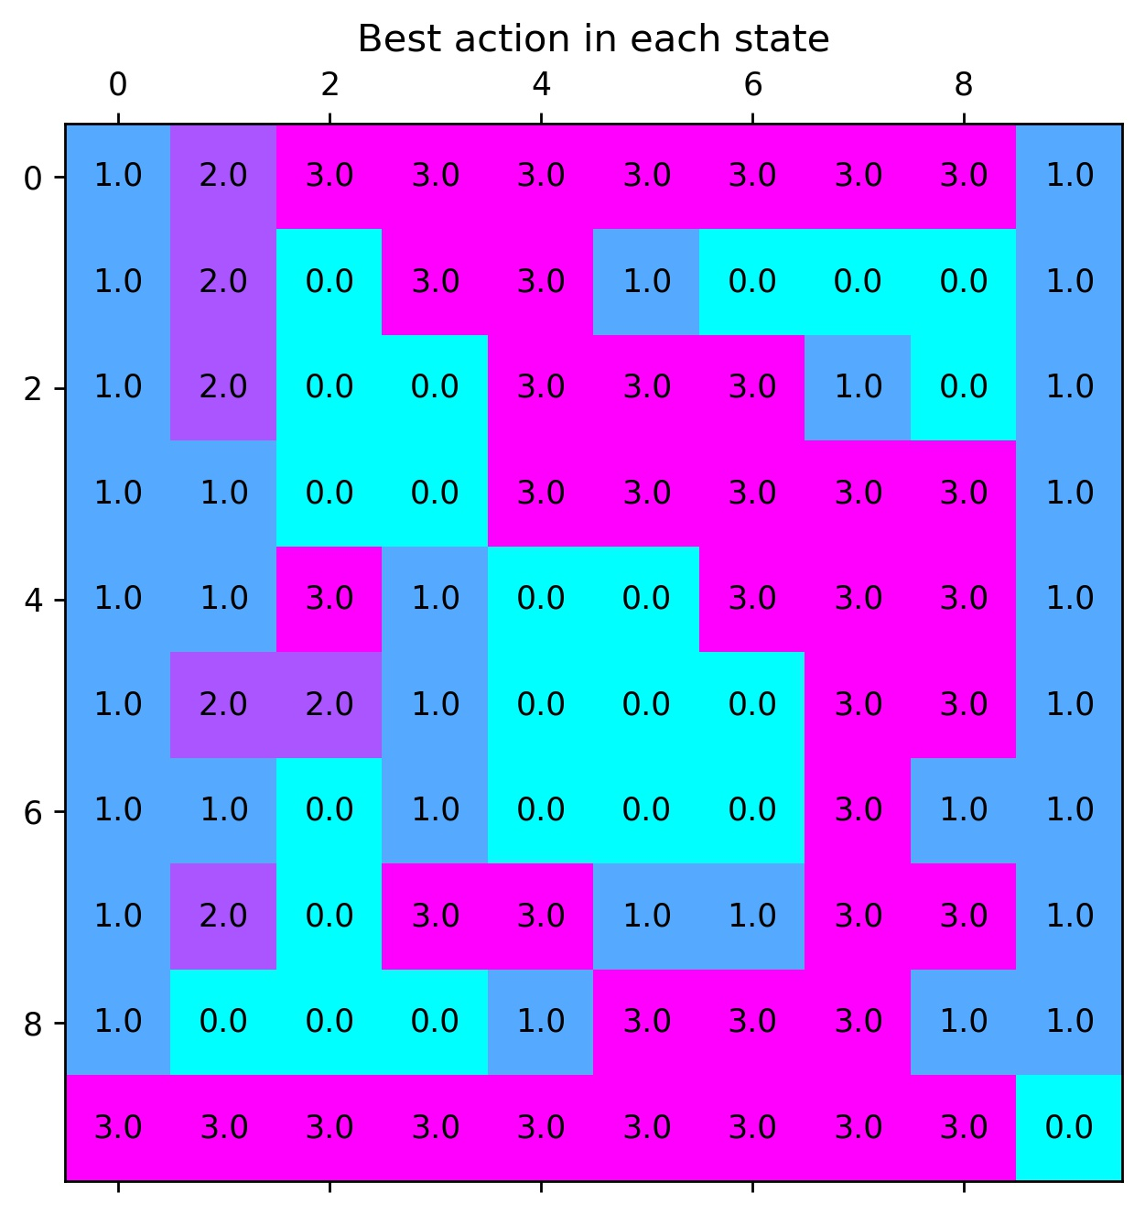





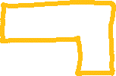

















Method 1: Monte Carlo Sampling
Train the agent on the environment using the 4 actions we have: [Up, Down, Left, Right] [0, 1, 2, 3].
Our agent will converge to a policy that looks like this:
Once we converge to this policy, we can rollout this policy for many episodes and compute the mean and standard deviation of return we receive from each state.

Slide 10
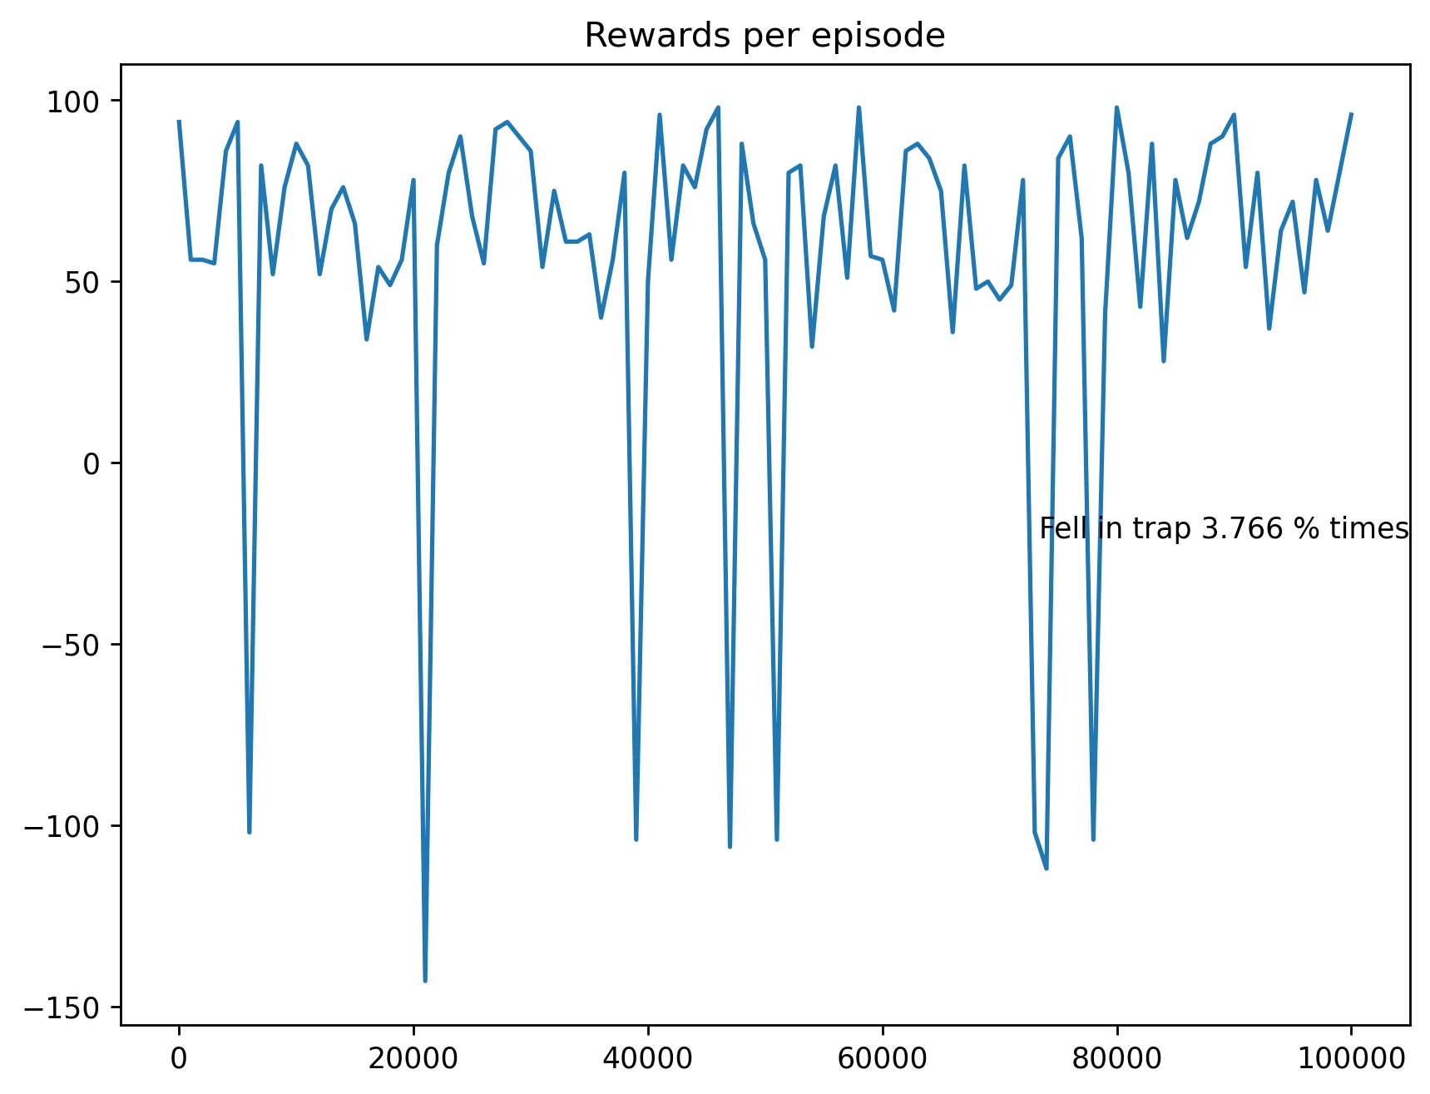
MC Sampling on learned policy.
On the policy that we have learned we will run 100,000 episodes to estimate the mean of returns and the standard deviation of returns from each state. We also look at the total return for each episode
Unsmoothed returns plot

Slide 11
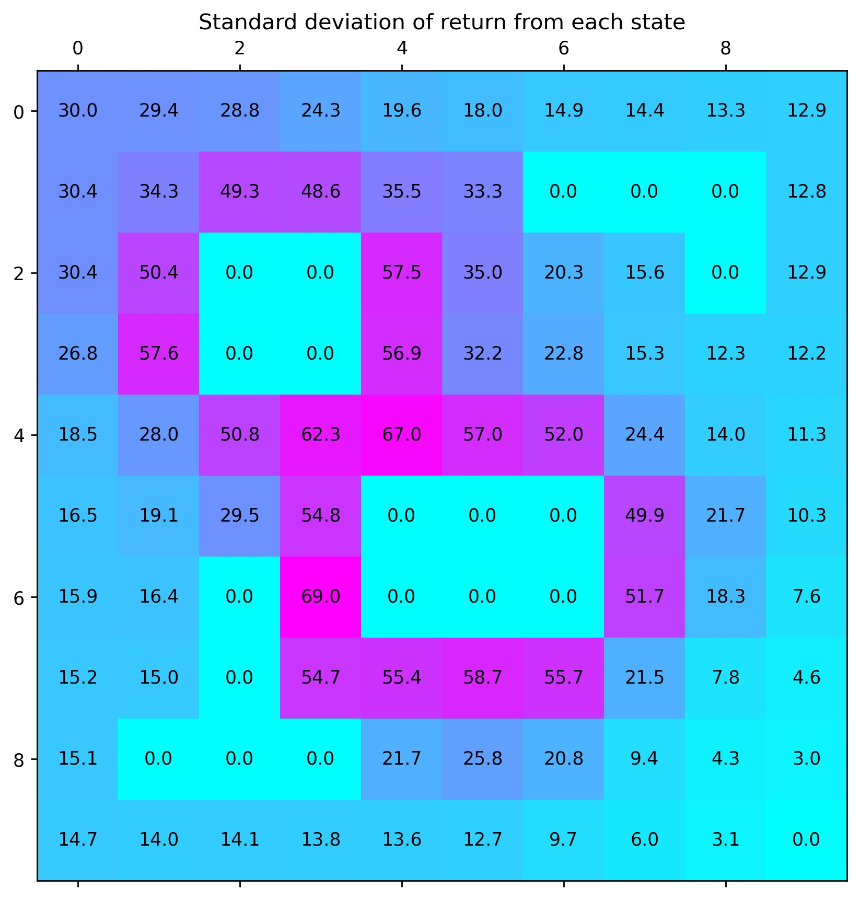
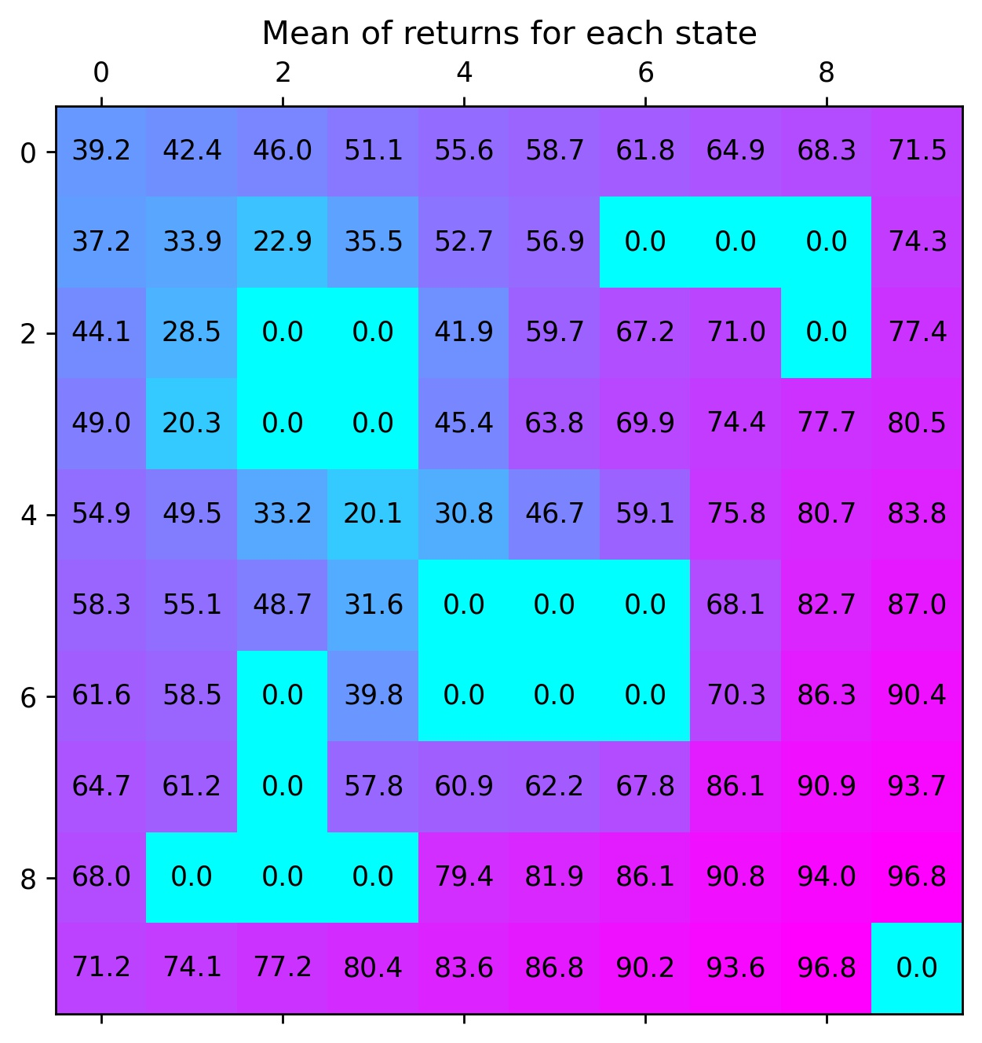
Notes:
This method does not make computational sense.

Slide 12






Method 2: Computing Variance using Bellman Equations
We can compute the Variance of return using bellman equations as well. The math behind this is wonderfully explained in this pdf:
A brief of the math

Slide 13
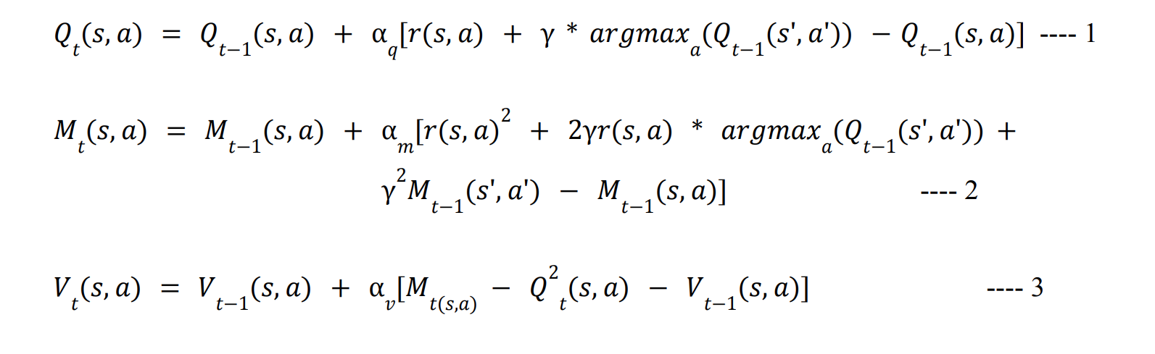


Final Equations

Slide 14
Method 2 on Grid-World
Using this method, we are computing the q values, second moment of returns and the variance of returns for each state action pair during training.
Hence, we have [10x10x4x3] values that we have learnt during the training of this environment.
So, like in the previous method we are computing the q values for each state action. However, we do not need to perform MC sampling since we are also computing second moment of returns and the variance of returns during training time itself
Our best action plot as expected is similar to the one in method 1

Slide 15
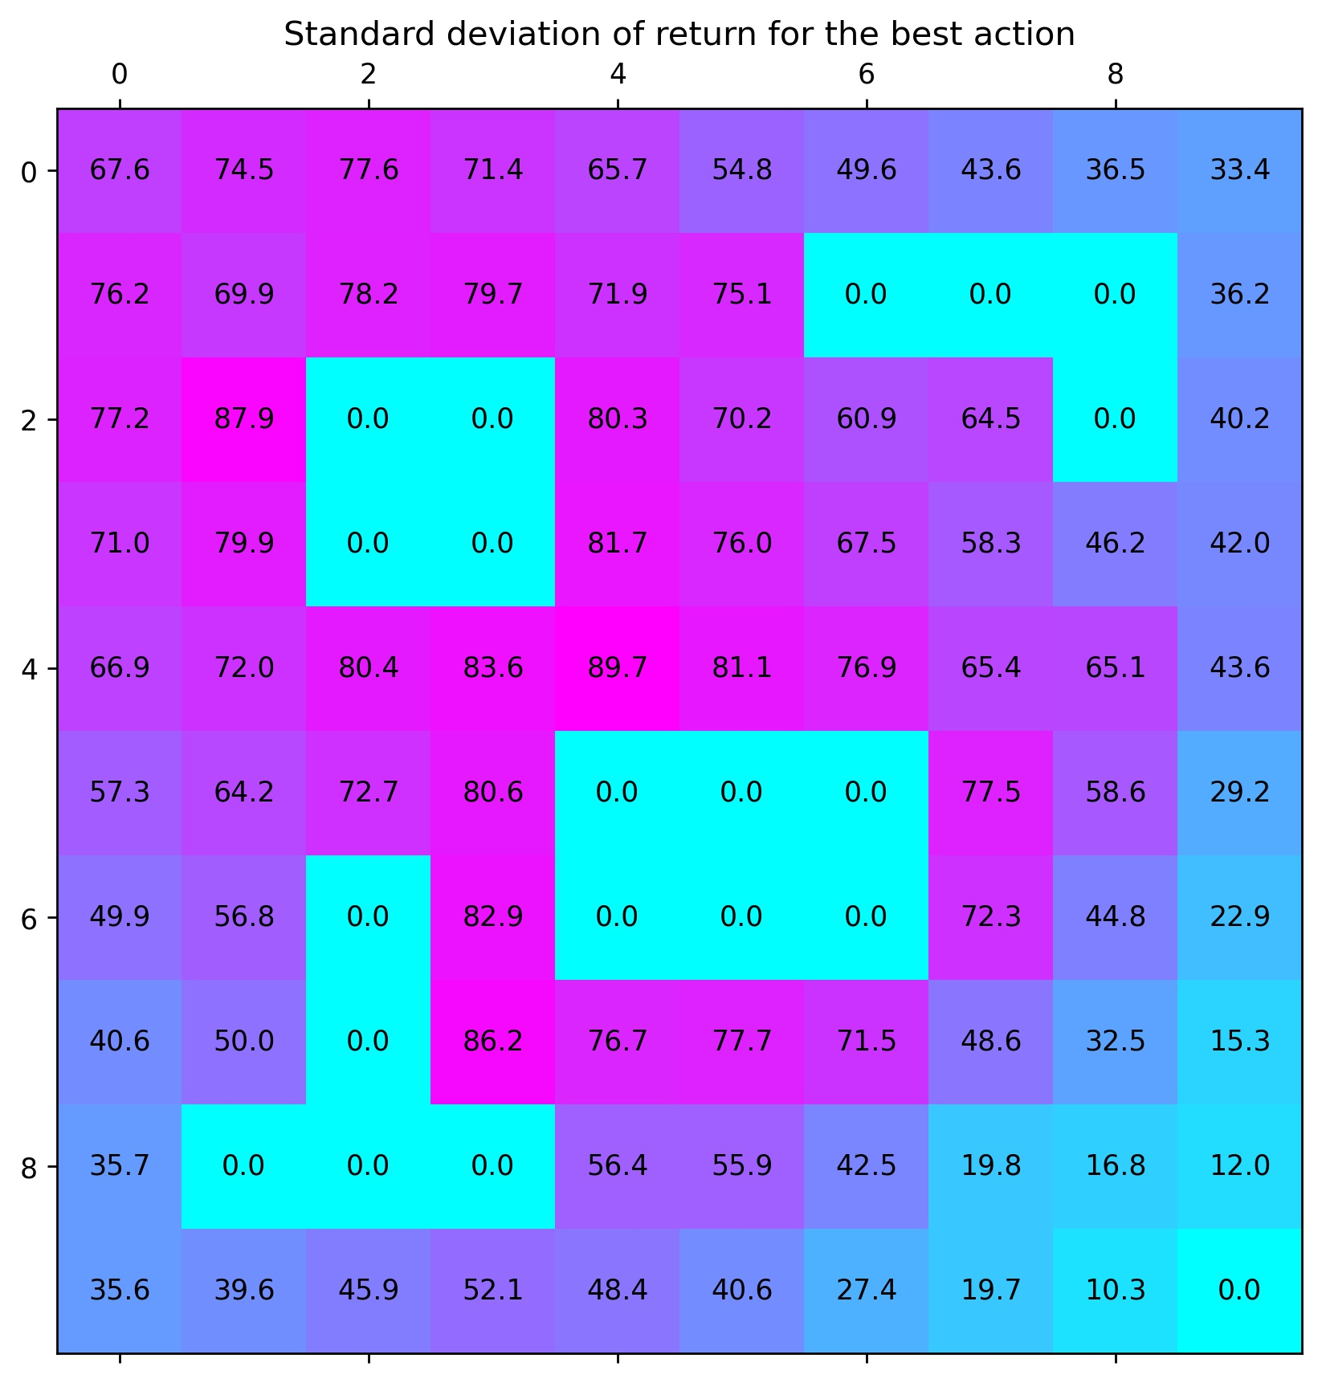
Comparing variance values using both methods
Method 1: Variance using MC sampling
Method 2: Variance using Bellman
Notes:
As you can see, the learned standard deviations calculated in both ways result in somewhat similar plots. The method on the left is more of a baseline to computing the variance and is not practical in real training. It is shown only to compare our values with our proposed algorithm

Slide 16
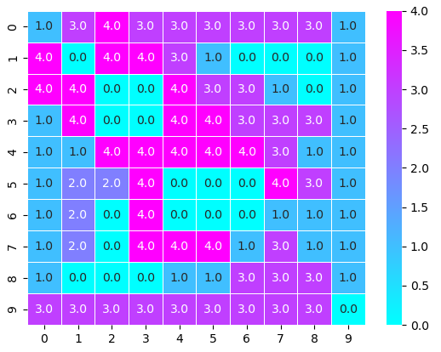
Introducing the expert
We introduce a new action our agent can take that is calling the expert. So now the agent can take actions [Up, Down, Left, Right, Call Expert] with numbers: [0,1, 2, 3, 4]. When the expert is called, we have a fixed set of actions that the expert takes in each cell which is predefined. To avoid multiple calls to the expert there is a reward of -5 associated with calling the expert. Also, the stochasticity does not apply when the expert is called, so if the expert takes a particular action, then the environment will execute said action with certainty.
Now we need to modify our policy to include this new action. We will use our learned std_dev plot from method 2 (computing variance using bellman equations) for this. If the variance is above a certain threshold, that indicates that the agent is unsure about the action it is about to take and so we can call the expert instead. For different values of the threshold, we will get different policies. Our learned policy will look something like this:
Policy when threshold=5700
Notes:
Note that our new learned policy is calling the experts near the traps where it is most uncertain of its actions.

Slide 17
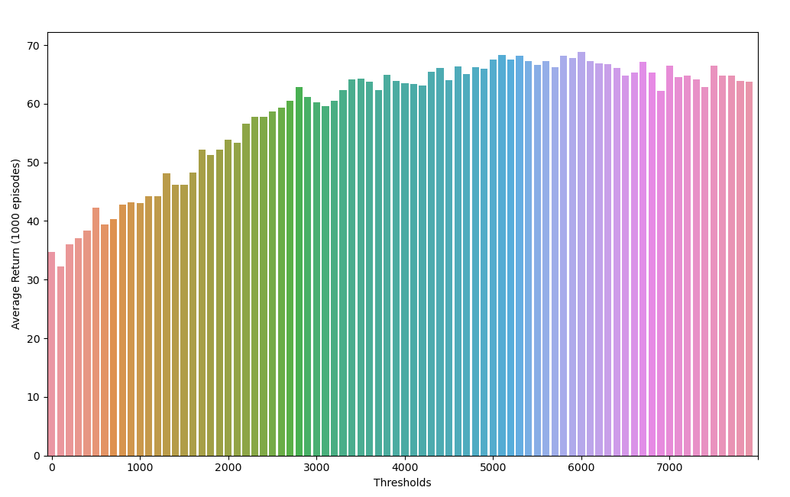
Changing the thresholds
We obtain a different policy for different values of the threshold. Below I have plotted the average return I receive across 1000 episodes for different values of the thresholds
As the threshold value is increased the expert is called less often.
At lower thresholds the agent does not trust its own learned policy very much and calls the expert many times, which results in high costs of calling the expert.
As threshold values get very large, the expert is not called very often and the expert trusts its own actions a lot, this results in a slight dip in the average returns.

Slide 18
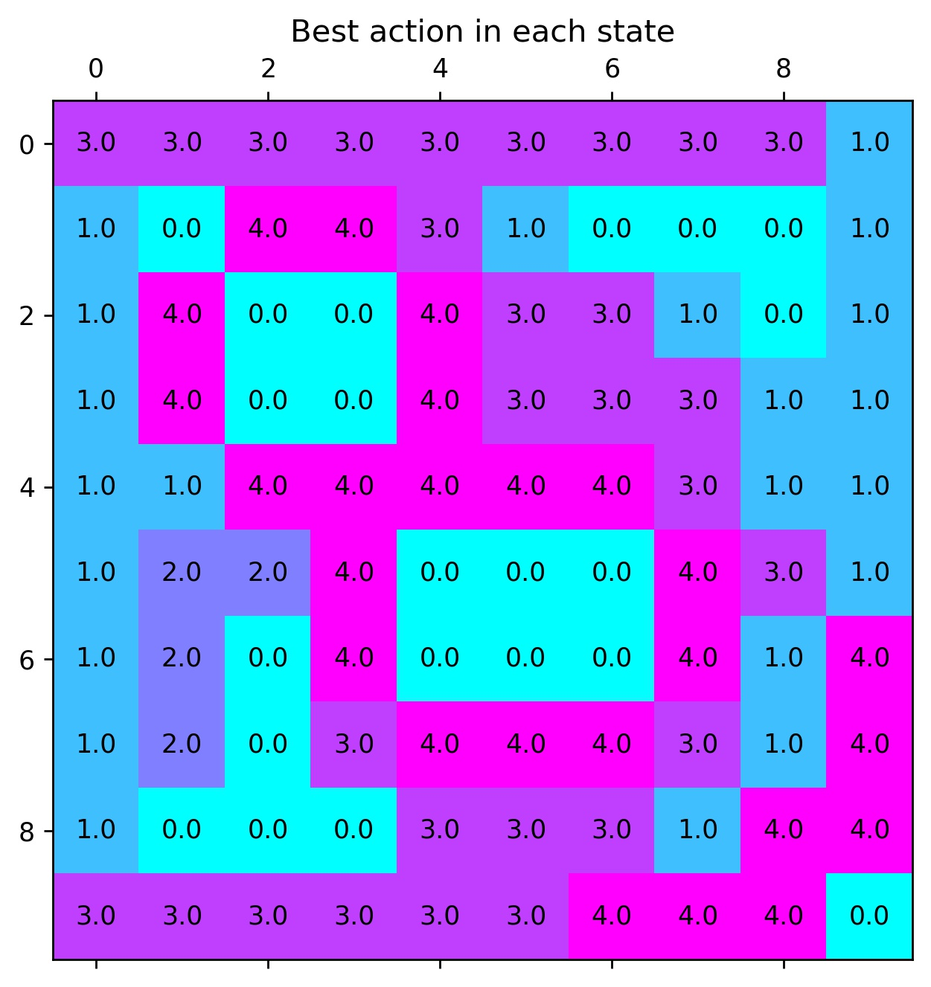
ALG1
We can add include the expert call as a 5th action while training again with a reward of -5 and let the agent figure out when to call the expert or not. This results in the following kind of policy:

Slide 19
Vanilla vs ALG1 vs ALG2
A vanilla agent is one which is trained in the same way but has nothing to do with variance or an expert call.
ALG1 has an expert as the 5th action it can take
ALG2 learns the variance of the actions using Bellman equations and finds a policy by calling the expert when the variance is above a certain threshold.
Algorithm | Average Return (1000 episodes)
Vanilla | 66
ALG1 | 58.1
Method 2 | 68.4

Slide 20
Future potential
Currently the variance computation has been tried out with discrete actions. If we can figure out a way to compute the same for continuous methods like PG variants, it could become very beneficial. Not only will we be able to include a human in the RL loop to take better high risk decisions, but it will also be a great way to visualize the actions being taken by our agent at each step and understand which areas need improvement.
Note that all of this can be done at barely any additional cost while training.

